Slide 1
A Tutorial of
MongoDB II
MIS 634
Business Intelligence & Data Integration - LAB

Slide 2
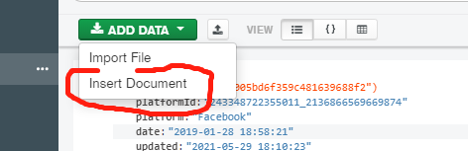
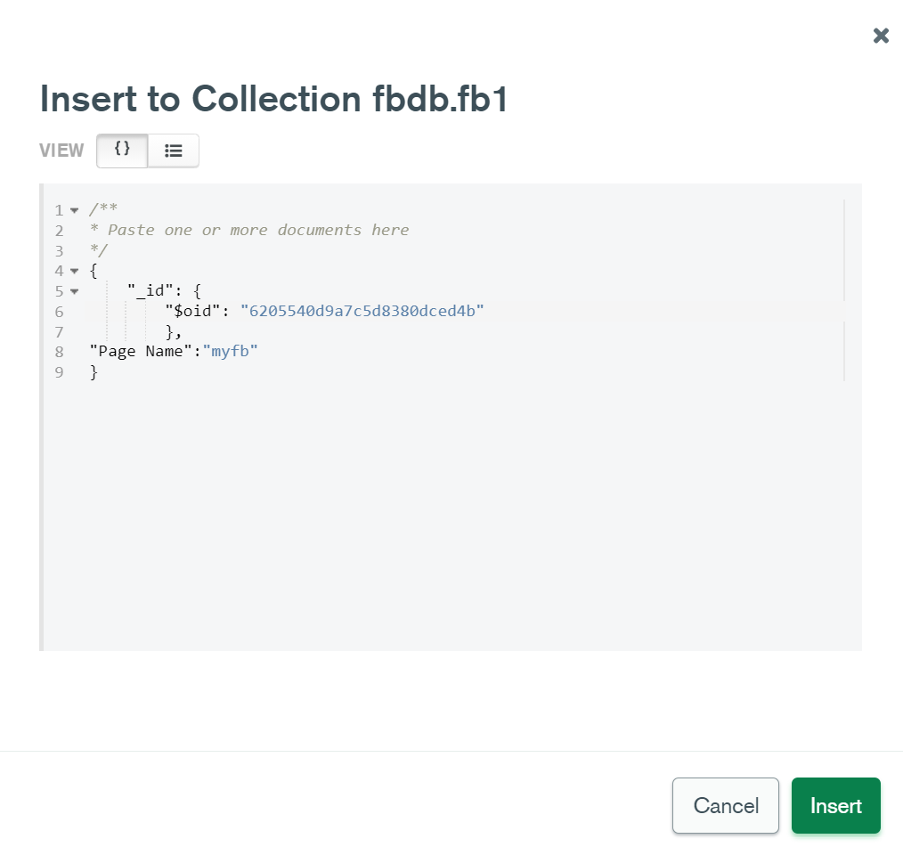
MongoDB CRUD Operations
Create: Adds new document to a collection
db.<col name>.insertOne(doc)
db.<col name>.insertMany([doc1,doc2,…,docn])
show dbs # display all the databases use Facebook_DB #select database
db.fb1.insertOne ({"Page Name": "my_fb"})
db.fb1.insertMany([{"Page Name": "my_fb"},{"test":1}])

Slide 3
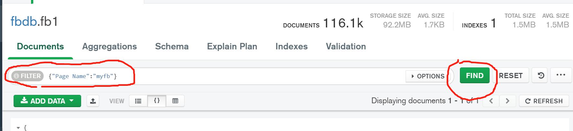
MongoDB CRUD Operations
Read: Queries documents from a collection (Think of SELECT in SQL)
db.<col name>.find(query)
Query example: status: { $in: [ "A", "D" ] }
db.fb1.find ({"Page Name":"eBay"}) db.fb1.find({"Page Name":"eBay"}).count() db.fb1.find ({"Page Name":"eBay", "Type":"Link"}). pretty()

Slide 4
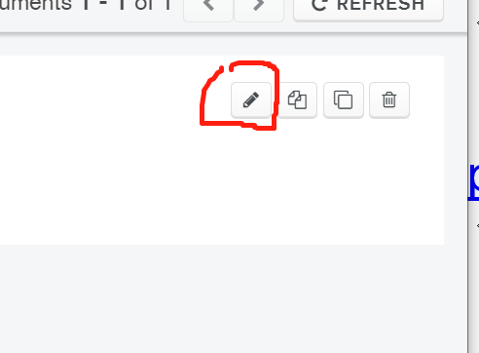
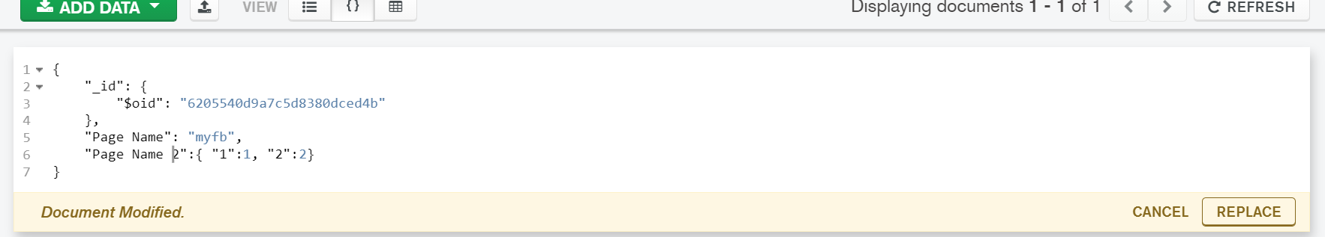
MongoDB CRUD Operations
Update: Update a set of documents with given filter
db.<col name>.updateOne(<update filter>,<update action>)
db.<col name>.updateMany(<update filter>,<update action>)
Update operator: $inc, $set, etc (https://docs.mongodb.com/manual/reference/operator/update/)
db.fb1.updateMany({"Page Name":"eBay"},{"$inc":{"Likes":3}}) db.fb1.updateMany({"Page Name":"eBay"},{"$set":{"Likes":3}}) db.fb1.updateMany( {},[{"$set":{“Likes": {"$toInt":"$Likes"}}}])

Slide 5
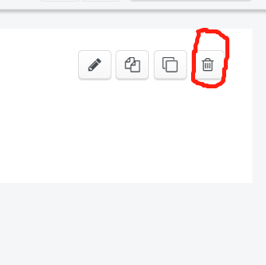
MongoDB CRUD Operations
Delete: Delete a set of documents with given filter
db.<col name>.deleteOne({<field1>: { <operator1>: <value1> }, ... }) db.<col name>.deleteMany({<field1>: { <operator1>: <value1> }, ... })
db.fb1.deleteMany({"Page Name":"eBay"}, {"Likes":{$gt:10}}) db.fb1.deleteMany({"Page Name":"eBay"})

Slide 6
MongoDB CRUD Operations
Read: Comparison Operator : {<field> : { <operator>:<value>}}
$in : Matches any of the values specified in an array.
$eq: Matches values that are equal to a specified value.
$gt: Matches values that are greater than a specified value.
$gte: Matches values that are greater than or equal to a specified value.
$lt: Matches values that are less than a specified value.
$lte: Matches values that are less than or equal to a specified value.
$ne: Matches all values that are not equal to a specified value.
$nin: Matches none of the values specified in an array.
db.fb1.find({"Likes":{$eq:10}}) db.fb1.find({"Likes":{$gt:10},"Type": {$in: ["Link", "Photo"]}})

Slide 7
MongoDB CRUD Operations
Read: Logic Operator : {<operator>: [ { <expression1> }, { <expression2> } , ... , { <expressionN> } ]}
$and: Joins query clauses with a logical AND returns all documents that match the conditions of both clauses.
$not: Inverts the effect of a query expression and returns documents that do not match the query expression.
$nor: Joins query clauses with a logical NOR returns all documents that fail to match all clauses.
$or: Joins query clauses with a logical OR returns all documents that match the conditions of either clause.
db.fb1.find({$and:[{"Page Name":"eBay"}, {"Type": {$in: ["Link", "Photo"]}}]})
db.fb1.find({$and:[{"Likes":{$gt:10}},{"Type": {$in: ["Link", "Photo"]}}]})
if your code doesn’t work, why?
$ here indicate the field
!
db.fb1.updateMany( {},[{"$set":{“Likes": {"$toInt":"$Likes"}}}])

Slide 8
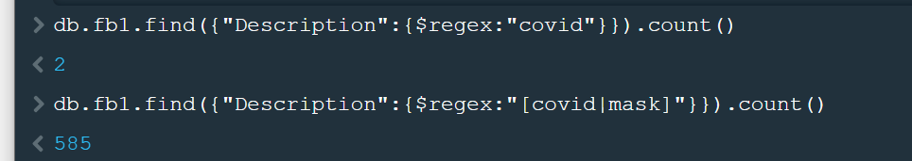
MongoDB CRUD Operations
Other Query Operator: https://www.mongodb.com/docs/manual/reference/operator/query/
Element Operator, such as $exists: db.fb1.find({"test": {$exists: true}}) db.fb1.find({“Likes": {$exists: true}})
Evaluation Operator, such as $regex $regex: MongoDB uses Perl compatible regular expressions (i.e. "PCRE" ) version 8.42 with UTF-8 support. https://en.wikibooks.org/wiki/Regular_Expressions/Perl-Compatible_Regular_Expressions https://regex101.com/ db.fb1.find({"Description":{$regex:"covid"}}) db.fb1.find({"Description":{$regex:"[covid|mask]"}})
db.fb1.find({$and:[{"Description":{$regex:'covid'}},{ "Type": {$in: ["Link", "Photo"]}}]})
Regular Expression is important !

Slide 9
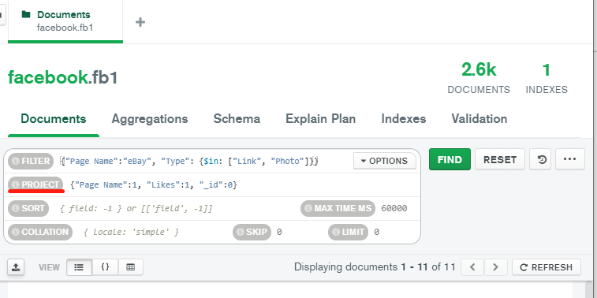
MongoDB CRUD Operations
Read: Projection: db.<collection>.find({<query>},{<projection>})
1: include the field
0: exclude the field
Use only 1 or 0 -- Do not use them at the same time
db.fb1.find({"Page Name":"eBay", "Type": {$in: ["Link", "Photo"]}}, {"Page Name":1, "Likes":1})
db.fb1.find({"Page Name":"eBay", "Type": {$in: ["Link", "Photo"]}}, {"Page Name":0, "Likes":0})
db.fb1.find({$and:[{"Description":{$regex:"[covid|mask]"}},{ "Type": {$in: ["Link", "Photo"]}}]},{"Page Name":1, "Likes":1})
Let’s try:
db.fb1.find({"Page Name":"eBay", "Type": {$in: ["Link", "Photo"]}}, {"Page Name":1, "Likes":1, "_id":0})
Exception

Slide 10
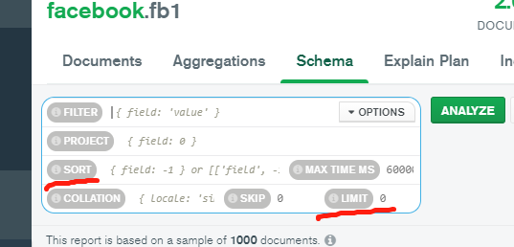
MongoDB: Cursor Methods
Not applied to the data but to the result For Example:
db.fb1.find ({"Page Name":"eBay", "Type":"Link"}). pretty()
You can find all the cursor methods: https://www.mongodb.com/docs/manual/reference/method/js-cursor/
Count()
db.fb1.find ({"Page Name":"eBay", "Type":"Link"}). count()
Sort() & limit()
db.fb1.find ({"Type":"Link"}).sort({“Likes":-1})
db.fb1.find ({"Type":"Link"},{"Page Name":1, "Likes":1}). sort({"Likes":-1}).limit(3)
1: Ascending
-1:Descending

